Slide 1
ENGI 301 <Repeat Pattern Mini Game> Proposal
<9/25/2023>
<Ananya Lingineni>

Slide 2
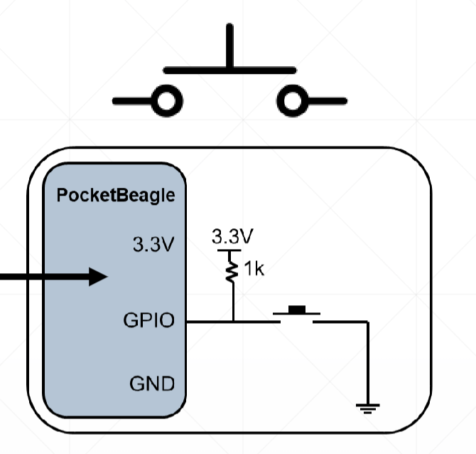
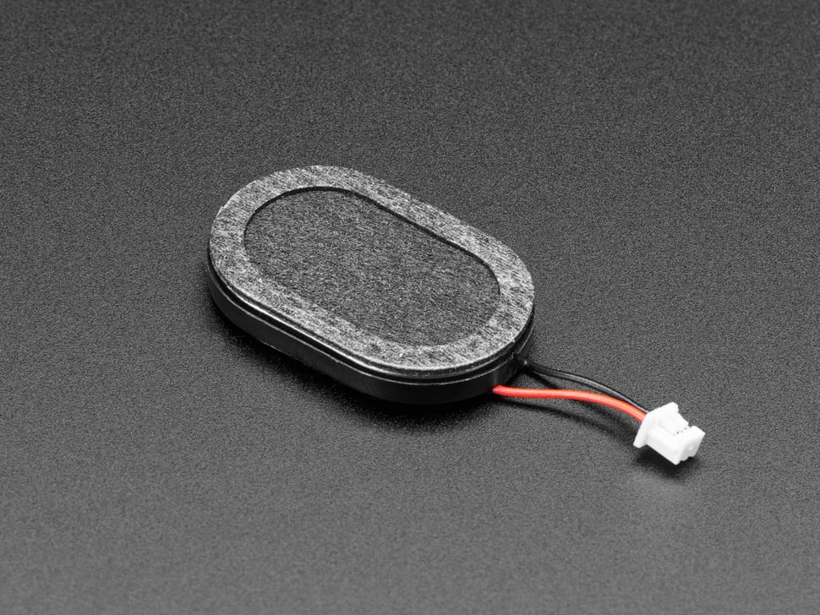
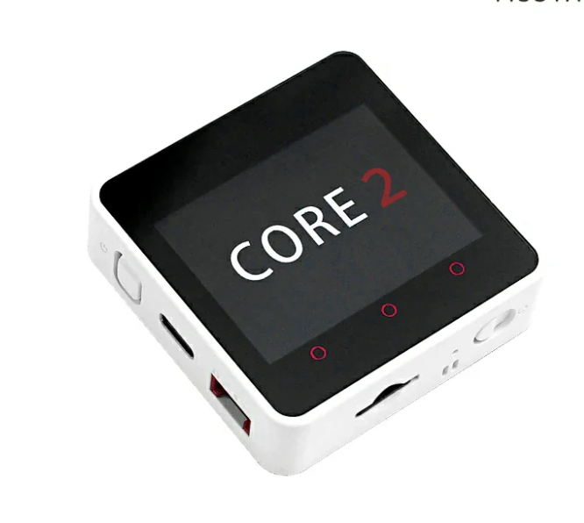
Background Information
I am proposing a mini game with a screen, buttons, and a speaker. The screen will outplay a pattern which the user then has to mimic on the buttons. The pattern will increase by one color each round and the user tries to get as high a score as possible. Each color of the pattern will also correspond to a sound that will be outputted on the speaker.

Slide 3
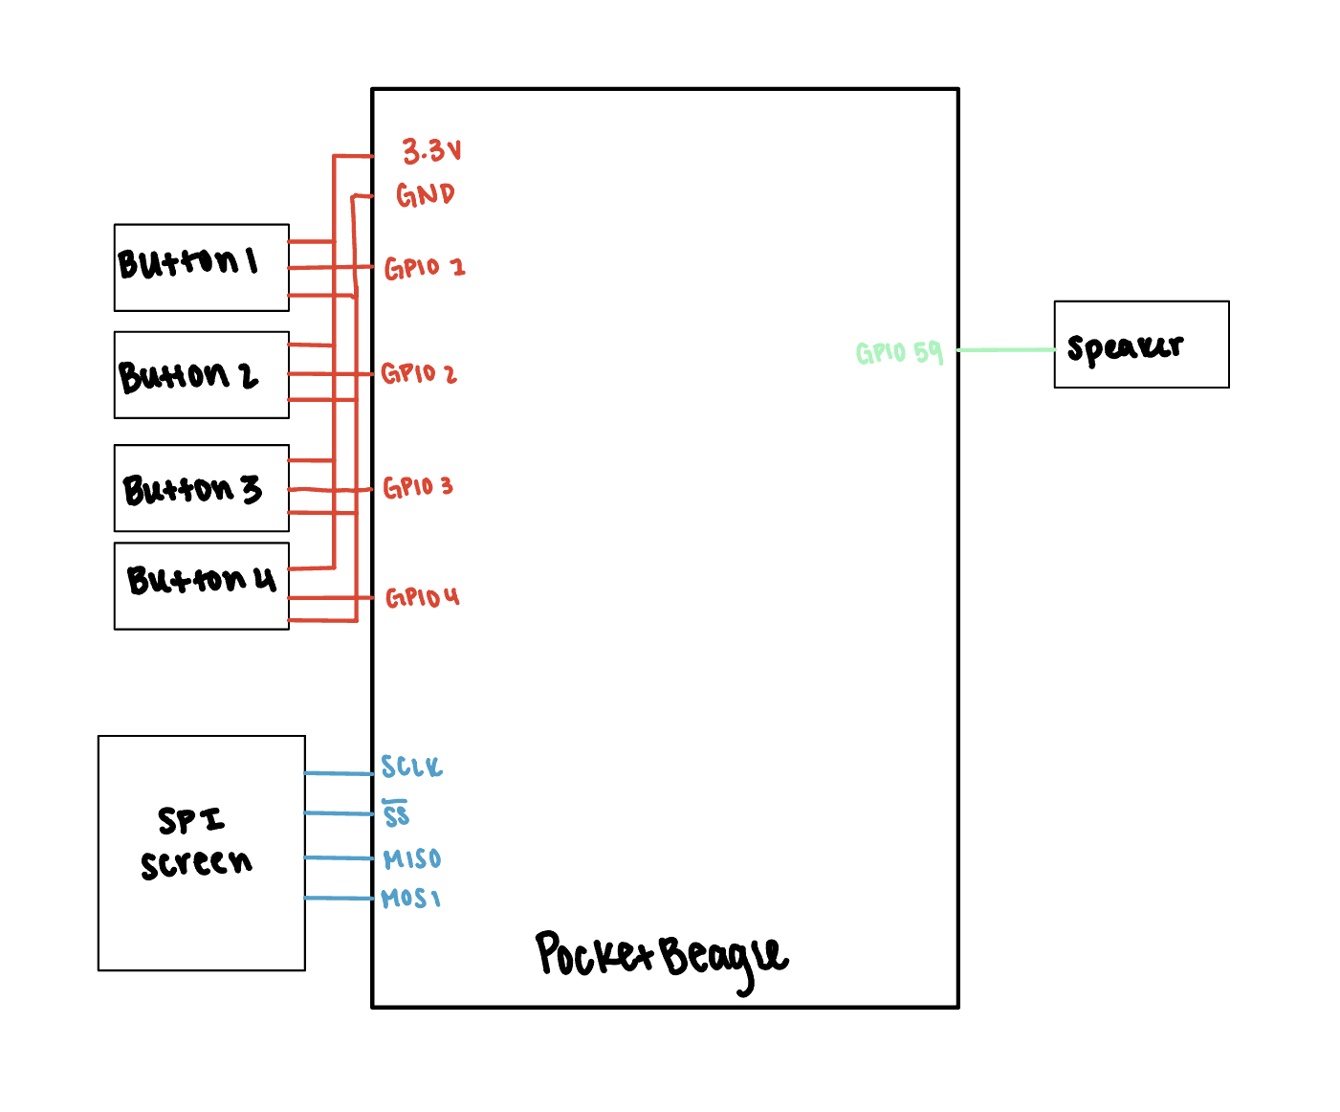
System Block Diagram

Slide 4
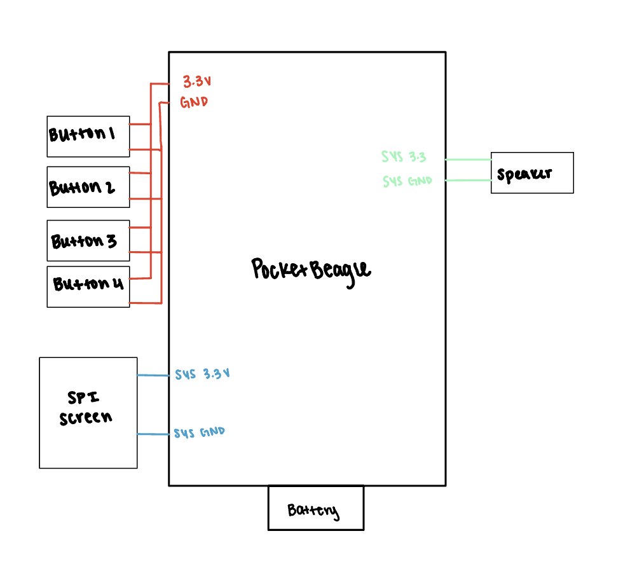
Power Block Diagram

Slide 5
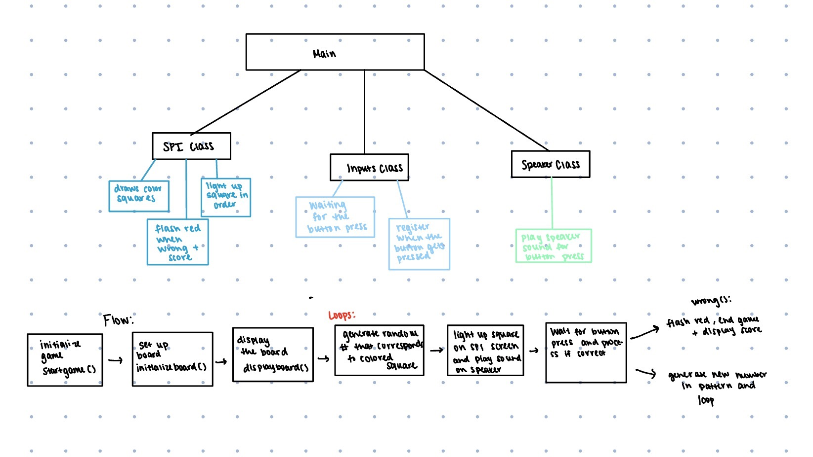
Software Block Diagram

Slide 6
Components / Budget
Component | Need to Buy | Cost
Buttons x4 | No | In Parts Kit
Mini Oval Speaker with Short Wires - 8 Ohm 1 Watt | Yes | $1.95
SPI Screen | Yes | $29.95
5 V Battery | No | In Parts Kit
See Next Slide for Instructions

